Slide 1
1080
To bait or not to bait?

Slide 3
What is 1080?
Sodium fluoroacetate (1080)
Sodium fluoroacetate (1080) is a naturally occurring poison found in plants in Australia, South Africa and Brazil.
1080 is highly toxic to mammals, including humans, and is primarily used for protecting sheep and goats from predatory coyotes (predacide). In the Unites States, Texas, New Mexico, Wyoming and Montana are the only states that provide the required certification and training programs for use of 1080. Within those states, application is restricted based on potential harm to endangered species.
In New Zealand, 1080 has been widely used for the control of non-native rodents, such as possums, that have no natural predators New Zealand has used 1080 for pest control since the 1950's, while the United States began use in the 1940's

Slide 4
History
The toxic nature of fluoroacetic acids were discovered in western Australian and South African plants, where accidental poisoning of livestock occurred.
The earliest documented synthesis of fluoroacetic acid was by a Belgian scientist. In the 1930's, Germany patented the acid and it was used as a moth deterrent.
It was separately discovered by Polish military researchers in the late 1930's and tested during World War II in Nazi-occupied countries. Scientists in England learned of the compound from a Polish scientist who escaped to England.
In the 1940's, the United States continued fluoroacetic acid compound research, and sodium fluoroacetate and a related compound fluoroacetamide were both developed as rodenticides.
Restrictions and regulations were placed on both compounds throughout the 1970's and 1980's, and fluoroacetamide was cancelled in 1989.

Slide 5
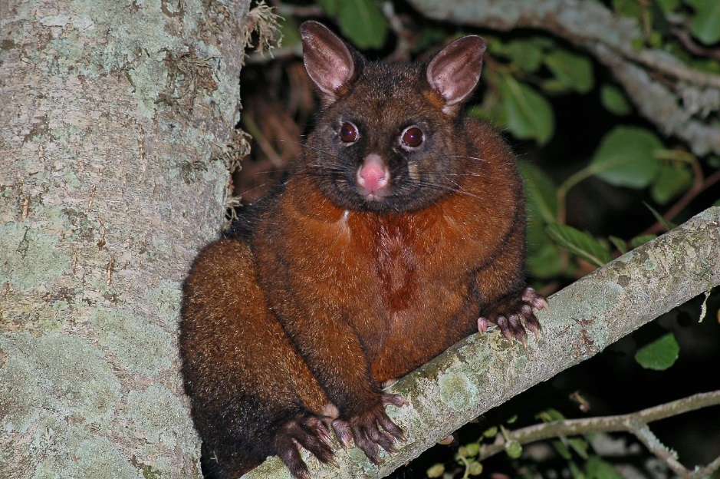
Why 1080 in NZ??
The main threat to many of New Zealand’s native plants and animals comes from introduced predators such as possums, rats and stoats. New Zealand has no native ground dwelling mammals so native species like birds, snails, lizards and insects are particularly vulnerable to these imported tree climbing predators.
1080 is very effective in controlling these introduced pests and well suited to New Zealand conditions. It can be safely applied by air and it is the most cost-effective method of providing landscape scale pest control over difficult terrain.
A fast, tactical knockdown of possums, rats and stoats is often needed in the spring to protect birds during the nesting season. This is especially important in ‘mast years’ when some native trees (especially beech) produce huge numbers of seeds. This abundance of food can lead to a plague of rats, which in turn leads to an increase in stoats – both of which eat vulnerable native birds, insects and lizards.

Slide 6
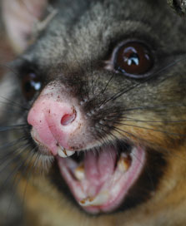
Case Study the NZ Brush Tailed Possum
In its native land the possum is up against dingoes, bush fires and less palatable vegetation. In New Zealand there are no predators and lots of very palatable vegetation. As a result, possums have a huge impact on New Zealand ecosystems.
The Australian brush tailed possum was introduced into New Zealand in 1837 to establish a fur trade.

Slide 7
Premier pest
Not only do possums destroy forests, they also infect cattle with bovine tuberculosis, threatening the country’s valuable dairy industry.
Their cost to the economy is considerable: in 2006 government agencies spent $111 million on possum control, a level of funding that will continue for another decade. In addition, possums eat pasture and cause a fall in farm production (estimated at $35 million annually). They also eat planted pine seedlings and horticultural produce.

Slide 8
Forest damage
Possums can cause catastrophic dieback, the complete collapse of a forest canopy – especially tree species that possums prefer, such as rātā and kāmahi. In the southern rātā–kāmahi forests of Westland, many valleys lost more than 50% of canopy trees within 15–20 years of possums arriving. The forest trees are then replaced by shrubs that are unpalatable to possums, and the area changes from tall forest to low open forest and shrublands.
http://www.teara.govt.nz/en/video/16897/possum-destruction-of-forest

Slide 9
Bird killers
In 1993 evidence was first uncovered of the effect of possums on native wildlife. A time-lapse video camera captured possums eating the chicks and eggs of the endangered kōkako. Of 19 nests monitored over a four-year period, cameras recorded possums eating chicks and eggs in four. Possums had not been suspected in the past because they were considered vegetarian, and because it is hard to find traces of birds in possum faeces or intestines.
http://www.teara.govt.nz/en/video/16899/possum-eating-a-chick

Slide 10
TB-infected possums
Bovine tuberculosis (TB), a contagious disease caused by the bacterium Mycobacterium bovis, is a serious threat to the cattle and deer farming industries.
The mystery of why some herds continued to be infected was solved in the 1960s with the discovery that possums carried TB. Cattle were sniffing or licking dead or dying possums that came out onto pasture, and so contracting the disease. Ferrets also spread TB.
Although on average only about 2% of possums actually have TB, there are pockets where the numbers infected may be up to 40%. Infected possums were present in about 38% of the country (10 million hectares) by 2003. Most die six months after contracting the disease. They become lethargic and stay out in the open during the day, where curious cattle lick the dead or dying animals and become infected. In their native Australia possums do not have TB, possibly because they have less chance of contact with cattle

Slide 11
Positive possums in NZ?
Possums have been harvested for their fur in New Zealand since 1921. The industry peaked in 1981 when 3.4 million skins were exported. Since then, demand for fur-on skins has been weak, but has been replaced by an increasing demand for plucked fur that is woven with merino wool to produce high quality yarn (e.g. Merinomink™, Perino™). The demand for plucked fur has grown about 10% per annum over the last 7 years (Fig. 1).
The use of plucked possum fur as a component in blended yarn is now well established with the New Zealand yarn industry estimated to be worth $50–70 million per annum. To service the demand for fur, about 1.5 million possums are now harvested each year, with about 80% of the fibre being processed into yarn for manufacturing into garments in New Zealand.

Slide 12
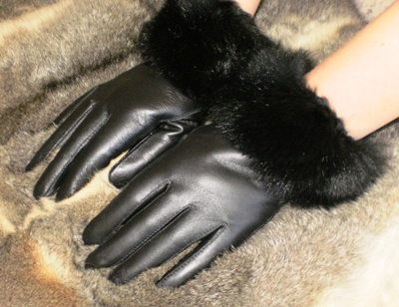
Possum fur in NZ!
http://www.etv.org.nz/programme.php?id=12939

Slide 13
Control Methods
The design and delivery methods of 1080 bait has evolved since its introduction to increase its efficacy on target animals and to limit non-target by kills. Baits that have been used in New Zealand include cereal baits, carrot baits, paste and gel baits. Cereal baits are manufactured by mixing 1080 with bran, kibbled grain and sugar. It is also essential for the cereal baits to be dyed green and cinnamon flavoured. The green dye makes it less attractive to birds and the flavouring masks the odour of 1080 to possums, and deer repellent can also be added.

Slide 14
How much 1080 is being used in baits?
To be effective it is recommended that baits should include 1.5 grams of 1080 per kilogram (i.e. 0.15% 1080 pellets). A case study shows more than 35% of possums that consumed cereal baits with lower toxicity (i.e. 0.08% 1080 pellets) survived
Analyse the graph opposite, why do you think that the amounts per hectare being used have reduced?

Slide 15
Aerial application
Aerial operations provide a cost-efficient means of reaching areas that ground operations simply cannot. Compared to ground operations, aerial operations can cover areas as large as 46,000 ha per operation. Due to economies of scale, this method of delivery is more affordable than ground operations. An aerial 1080 operation (including pre-feeding) can cost as little as $12 to $16 per hectare. Average sowing rates of 1080 cereal baits have also declined significantly from over 30 kg of bait per hectare in the 1950s to under 2 kg of bait per hectare today – equivalent to about four baits in an area the size of a tennis court.

Slide 16
The future of 1080 drops
Landcare Research has developed a more efficient method for aerial delivery of 1080 baits in clusters, rather than evenly, which could potentially reduce toxin use. Despite using 60% less 1080 bait (1 kg/ha), the reductions in possum activity indices achieved with cluster sowing (98.4%) were similar to those achieved with broadcasting sowing (97.8%). A cluster baiting method has been trialed with the baiting rate as low as 0.17 Kg/ha, significantly lower than normal sowing rate of 2 Kg/ha. In Otago, a new strip sowing method of applying bait is currently being trialed. Initial results show similar kill rates to other methods with a reduced amount of 1080 needed.

Slide 17
Ground operations
Ground operations are ideal for covering areas that have easy access and easy terrain. The main advantage of ground-baiting operations is their ability to limit non-target species by-kill. The baits are hand placed in bait stations that allow the target in but deter other animals, or applied directly to the ground. While ground operations may provide greater control over the operation, they are costly. The costs vary from $4 a hectare in easily accessible land to $80 per hectare in areas with difficult vegetation cover. With the average coverage area of only 4,000 hectare for each operation, ground baiting is not as time efficient as aerial operations.
What do you think the major risk of aerial operations of 1080 drops are compared to ground bait methods, list the advantages and disadvantages of both?

Slide 18
The issues
There are a number of reasons why anti 1080 advocates do not agree with the use of 1080 to control pest, we will cover a number below
What is 1080 and how does it work?
1080 is a metabolic poison that is extremely toxic to all air-breathing organisms. It blocks the body’s muscle and organs ability to absorb energy from its food, and results in a slow and inhumane death, typically 8 -24 hours for birds, 2-4 days for large mammals. There is no known antidote for this deadly poison.
Poisoning from 1080 occurs through eating the dosed baits (cereal pellets or poison-laced carrots) or from the flesh of poisoned animals. Carcasses remain poisonous until they are completely decomposed, which makes 1080 particularly lethal to dogs.
A number of people believe that 1080 is an inhumane way of killing pests, with the less ‘toxic’ baits being in fact more harmful to larger mammals due to slowing the process of killing the animal
Hind that has died as a result of 1080

Slide 19
Poisoning Paradise

Slide 20
The scale of the use of 1080 and its implications
During aerial poisoning operations, massive quantities (approximately 4000-100,000 kg of bait per drop) of poison-laced, palatable foodstuffs are introduced by helicopter or plane into New Zealand’s forest ecosystems and potentially into streams. The portion of poison per drop ranges from 10-400 km2.
New Zealand is now the world’s largest consumer of 1080. In most other countries 1080 is banned outright or severely restricted because of its lethality and its indiscriminate killing power.
There is considerable opinion that important damage could be done to NZ tourism and its brand name “100% Pure” labelling if DoC’s continual poisoning campaign with aerial 1080 were widely known outside New Zealand.
An estimated 20,000 deer are poisoned by 1080 each year.
If 1080 traces were ever found in exported food products such as milk and beef it could have important impact on New Zealand’s ability to export these products.
DoC assures the public that sensitive areas such as campsites, huts, walking tracks and waterways are avoided during aerial drops

Slide 21
Cartoon…
Interpret the Cartoon by answering the following questions
How has the possum been killed in the cartoon?
Do you think the cartoonist Al Nisbett is pro the use of aerial drops of 1080? Why?
What is the message that the cartoon sends about the use of aerial drops?

Slide 22
The imbalanced presentation of the science
Independent research has gathered overwhelming evidence of harm to some native species from aerial 1080 operations, and there is considerable evidence of ecological disruption, as one would expect given the indiscriminate nature of the aerial 1080 programme.
19 different native bird species have had corpses test positive for 1080 after aerial 1080 operations.
There is no credible scientific evidence that mass poisoning the forest ecosystems with aerial 1080 is of net benefit to native species.
All the science studies on bird mortality in 1080 drop zones refer to the small sample size, the lack of a control, and the need for long term population monitoring. These concerns are completely absent in DoC summaries.
Clear alternative methods of pest control are available, but are not adequately promoted or explored whilst there remains a total reliance by DOC/AHB on aerial 1080 operations
1080 pellet in waterway

Slide 23
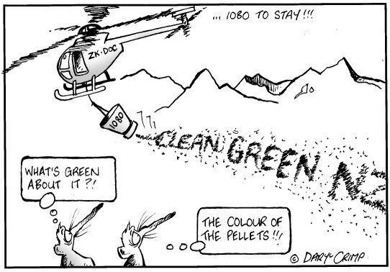
Interpret the Cartoon by answering the following questions
What is the promotional slogan in terms of tourism in New Zealand that the cartoon represents?
What does this slogan indicate to tourists about NZ?
Why do the possums? Have a confuse look on their faces?
Does the cartoon indicate that the cartoonist Daryl Crimp is pro or anti 1080 drops from Helicopters, Why?

Slide 24
Alternatives to 1080
The Pest Control Education Trust, and its sponsors are supportive of ongoing research into finding alternative methods of controlling possums and other mammalian pests. Use of toxins involves ethical issues and trade-offs, i.e. effectiveness relative to humaneness or how much suffering pests inflict on their prey. The same issues arise with regard to protecting our stock from Bovine TB. New Zealand has a responsibility on international and local levels to ensure survival of our native species. We also must protect our farms from disease. Concerns around the use of 1080 are often justified by assuming there are viable alternatives. All currently available alternatives have characteristics that in certain circumstances mean they are less efficient than 1080. Scientists, farmers and conservationists are widely united in the view that for now, 1080 is the best solution we have, and until such time as an effective alternative is found, it must remain a key component of New Zealand’s overall pest control strategy.

Slide 25
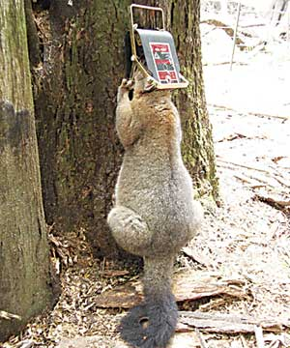
Trapping
Trapping The use of traps to kill predators advances every year. Innovative new traps using gas propelled bolts and positioning devices to ensure humane kills have come along way from the now banned and inhumane gin trap. Traps can be deployed effectively in easily accessible areas to control possum and stoat numbers. However rat populations are usually too high for traps to be useful. On a large scale, trapping is more expensive than 1080 due to the difficulty of reaching remote areas and being labour intensive. During mast events traps can simply not be deployed fast enough or in sufficient numbers to control pest numbers.
https://vimeo.com/63871834

Slide 26
Biological Controls
Biological Controls Biological controls have seen slow progress in recent years and most projects have been defunded because of this. There are also ethical issues with the public around introducing genetically engineered viruses or bacteria into the environment.

